Slide 1
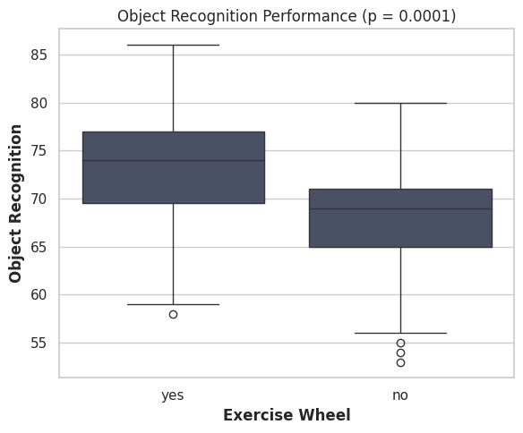
Do mice with exercise wheels perform better on object recognition?
An independent student’s t-test showed that mice who had access to exercise wheels in their cages performed significantly better in the object recognition test, t(118) = 4.03, p < 0.001.
NEURO-105 Maria Manousou

